Slide 1
2K21/CO/515 VIJAY KUMAR SAWHNEY
2K21/CO/495 TUSHAR SAI GUPTA

Slide 2


TABLE OF CONTENTS
Abstract
Introduction
Use Case Diagram
Entity Relationship Diagram
Data Flow Diagram
Implementation
Result
Conclusion

Slide 3
ABSTRACT
However, no proper software for the DMV has been made, at least in my country. Therefore, in this project, aim to design a DMV management system that mitigates the problems that Iand thousands of other applicants in the DMV have faced.
Efﬁcient storage, maintenance, and management of the vast amount of
data stored departments importance.
within government are of utmost

Slide 4
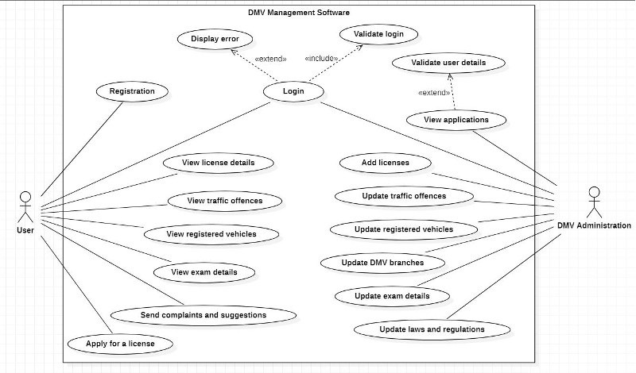
USE CASE DIAGRAM

Slide 5
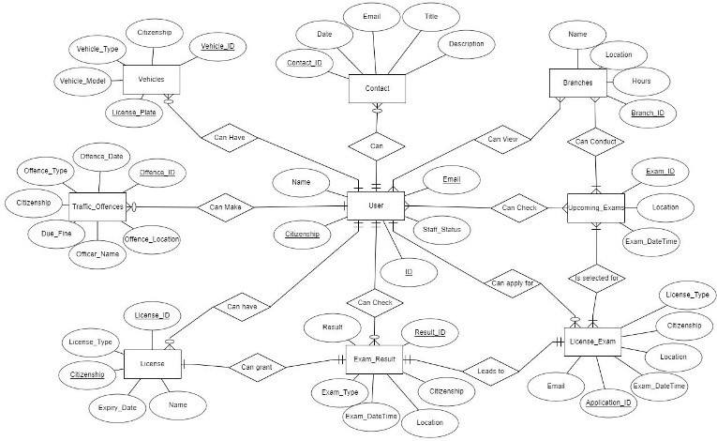
ENTITY RELATIONSHIP DIAGRAM

Slide 6
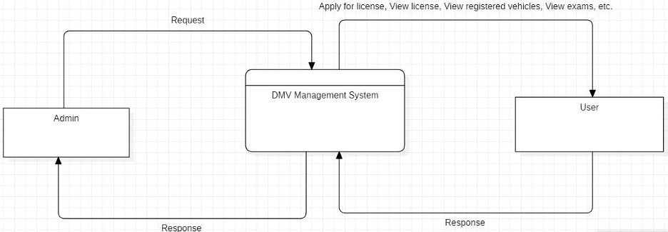
DATA FLOW DIAGRAM

Slide 7
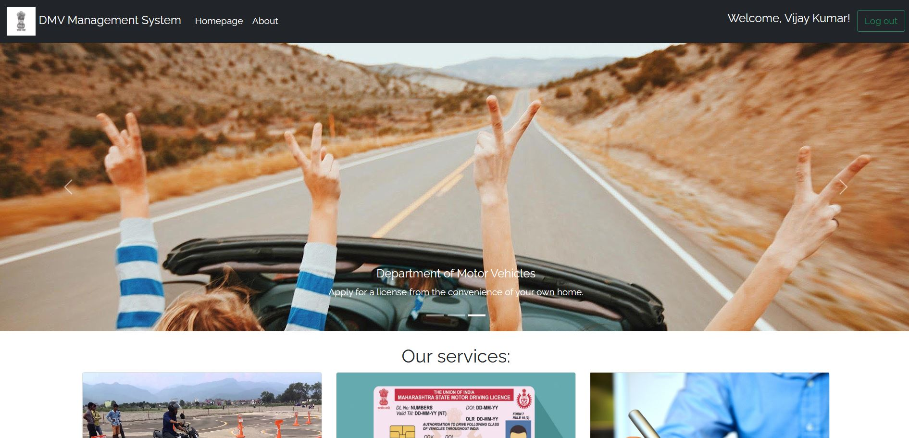
OUR WEBSITE
Our website is a replacement for
perfect generic
rto website with improved database collection and login systems
Based On DJango, HTML, CSS, Javascript and SQLite it provides an elegant and interactive UI to user and database could be stored easily

Slide 8





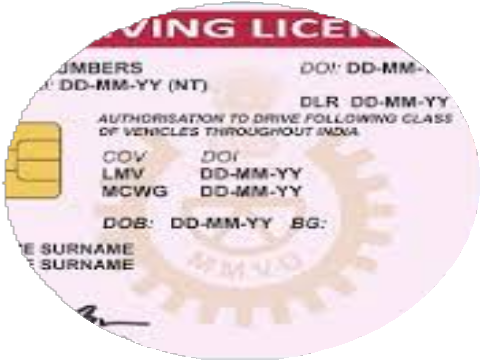



OUR FEATURES
Vehichle Registrations
Register your
vehichles Maintainence of cars
Advance. d Login
Improved login system using hashing and sqlite
License Services
Applying for license License Test Test Results
Past Track Record
Track Criminal Record

Slide 9
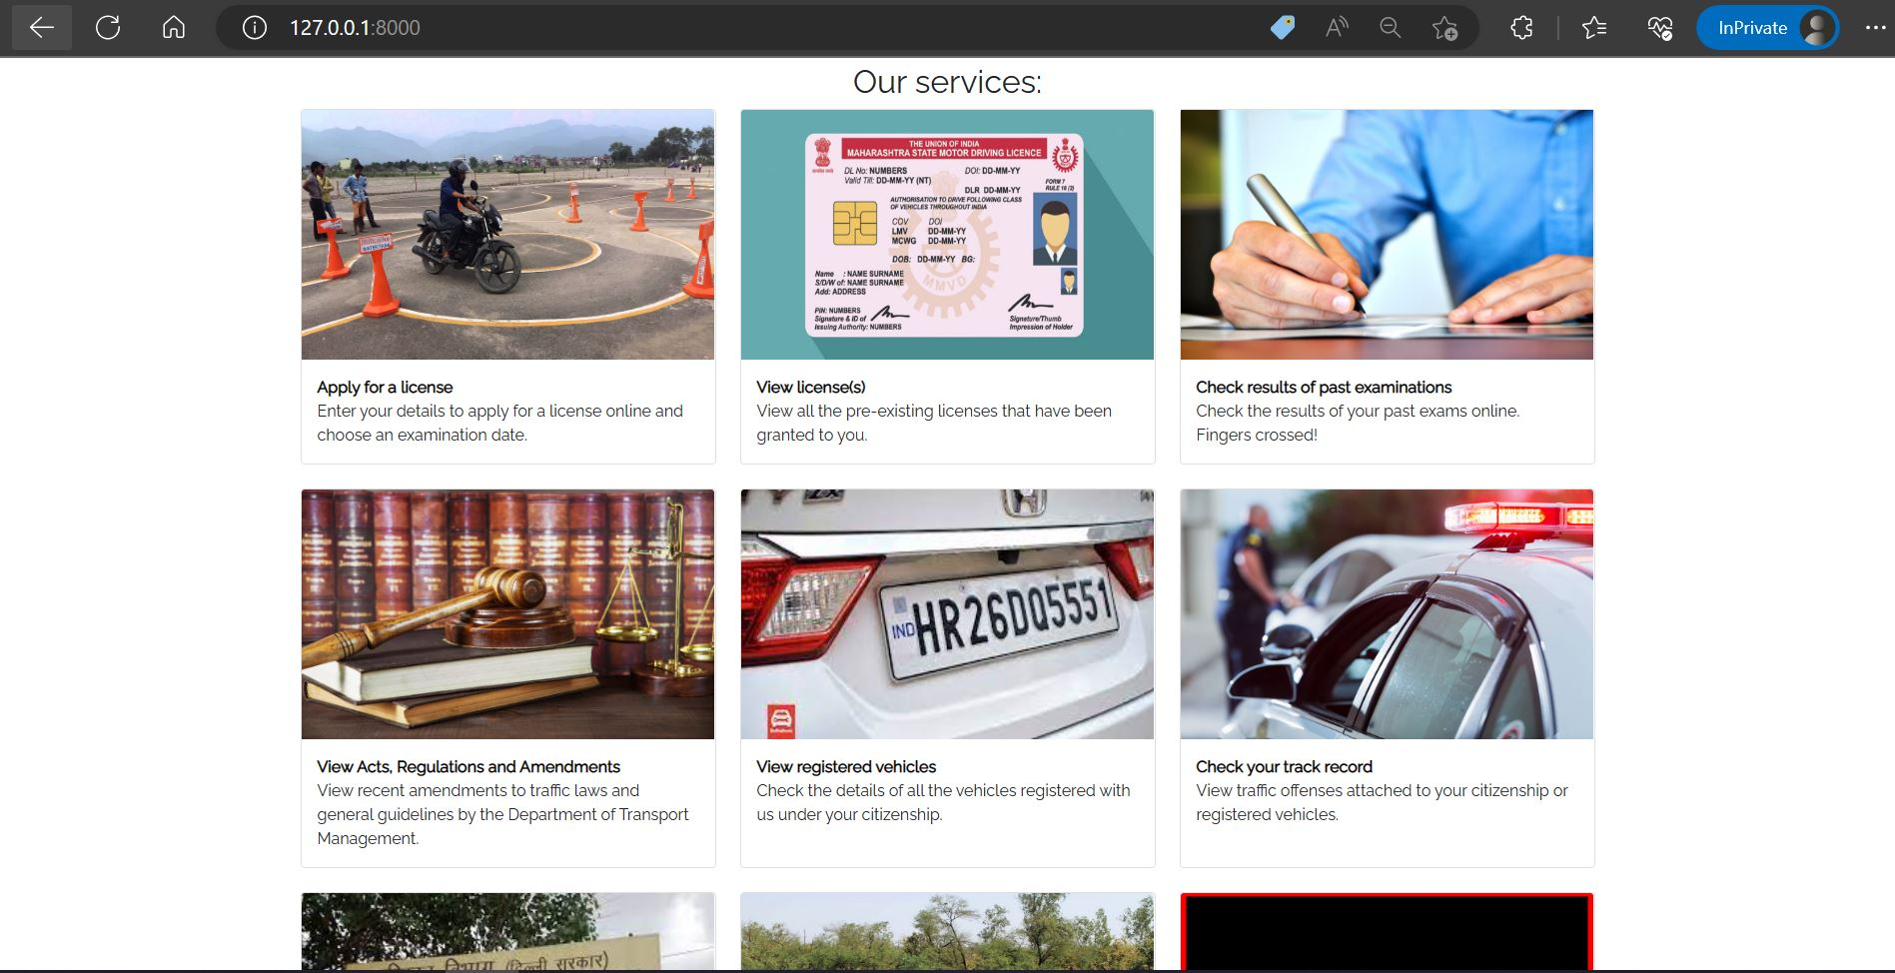
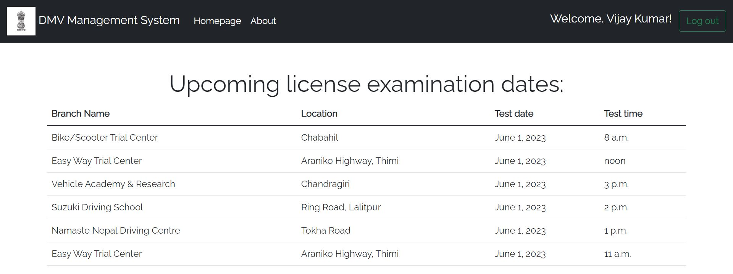
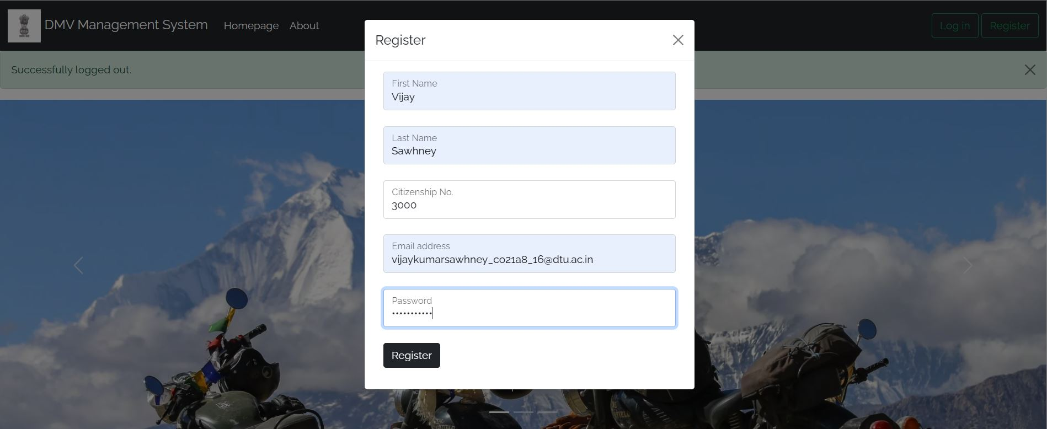
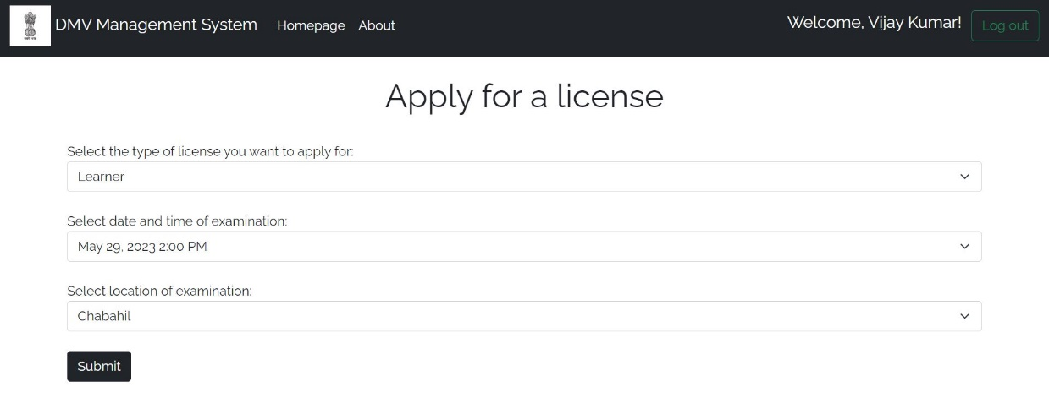
OUTPUTS

